Slide 1















Quality Assurance Committee
Dr Sally Priest, Flood Hazard Research Centre
on behalf of the QAC
4th September 2019

Slide 2
WP Self Assessment reports (Annex Q)
Thank you for all delivering the reports on time;
Reports show awareness of remaining activities/deliverables over the next year;
Majority of tasks to date have been delivered on time;
WP2 – Now completed. 2 additional reports have been delivered in addition to the scheduled tasks (“Best practice in teaching innovative teaching methods” and “Report on training of teaching staff for innovative teaching methods” )
WP4
  Delays reported in both the implementation of the masters currciula (due to accreditation delays) and associated quality reports
  Also in the realisation of student’s internships not fully completed
  BUT - now all programmes are accredited so this delay is now overcome

Slide 3
WP Self Assessment reports (Annex Q)
WP5
  Activities are pretty much on track. Regular reporting has been delivered as per the schedule (Annex R, Q and T, QAC report to management committee in March 2019);
  Worked to catch up on the Annex S reporting (deliverable checklist);
  External reporting recently delivered in Sept 2019
  Final reporting delayed until April 2020 due to the extension of the project
WP6
  Only comment is need additional promotional materials from the website.
  Additionally further updating of website is required (external quality report)

Slide 4
WP Self Assessment reports (Annex Q)
WP7
  WP7.2: Accreditation of master curricula – information was submitted on time – but still waiting. However, now all programmes are accredited
  WP7.3: SMS realisation, currently not all planned SMS have been realised – will be discussed in another session
WP8
  All planned activities realised on time
  Negotiated a no-cost extension to the project – to 14 April 2020

Slide 5
Partner Self-Assessment reports (Annex R)
Partners all report high awareness of their responsibilities and progress towards project outcomes;
No changes to the planned contributions were explicitly reported.
However, we know from the WP reporting that there have been some deviations (both delays and additions) to some WP including:
  Addition of two reports to WP2
  Delay in the Masters’ curricula accreditation
  It is recommended that these changes are added to the reporting.

Slide 6
Deliverable reporting (Annex S)
Much progress has been made on completing the Annex S checklists for each deliverable and these have been uploaded to the management portal
For outstanding tasks, please can WP leaders check that when a deliverable is submitted that an Annex S is completed and submitted alongside it to the QAC team

Slide 7
Internal Quality Audit
In general the partners reported very favourably about the project, its organisation and implementation – with few significant issues or comments raised;
86 questionnaires from individual respondents were returned during July and August 2019 (in comparison to 76 in 2018 and 66 in 2017);
The overall average response to all statements was 4.69 in close comparison to the 4.67 (2018) and 4.63 (2017)
All averages were in the Excellent category – with a range of between 4.50 and 4.81.

Slide 8
Internal Quality Audit
Relative scoring of the statements - focussing in on those statements which scored less highly or had a larger relative change from other years (either positive and negative);
Improvements (from 2018)
  I know about all the partners' tasks in the project (improved from 4.47 in 2017 to 4.73)
  Project is well presented in the media (improved from 4.49 in 2018 to 4.66)
Decline of scores in 2019
  Coordinator informs all partners on all aspects of activity implementation (4.80 in 2018 to 4.66)
  Project events (project meetings, workshop, trainings, and study visits) are well structured (4.78 in 2018 to 4.65)
  The project has a clear structure. The workflow follows a logic sequence (4.82 in 2018 to 4.66)

Slide 9
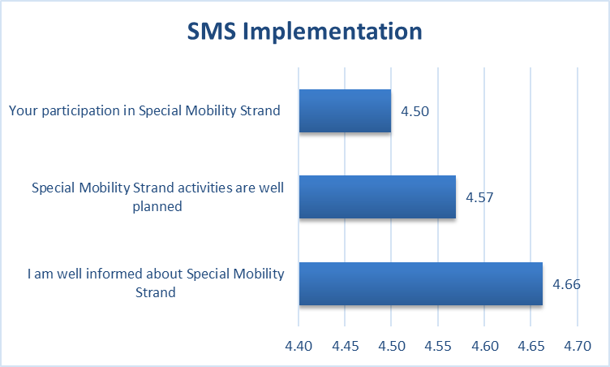
Internal Quality Audit
SMS Implementation – lowest scoring, but a significant improvement from last year (4.03, 4.50 and 4.65);
Participation in SMS improved scores
3.71 (2017), 4.03 (2018)
Realise that this may be a bit delayed – strategy for improvement;
But also whether all consider the question as applicable (i.e. if they have not been involved) – slightly lower response rate (n=84)

Slide 10
Additional Quality Reporting in 2020
The QAC needs to take a decision about whether to have any additional reporting in March 2020 now that we have an extension to the project.
It is taken as read that Annex S will be completed as each deliverable is completed.
However, with the agreement of the QAC it is proposed also to ask for an additional Annex Q and R.
Should we also undertake an additional internal quality audit of the project at the very end (Annex T questionnaires, Annex V)

Slide 11
External Quality Audit
September 2019

Slide 12
Some commendations
In general, there are some points of commendation and the report details the projects achievements to date;
Very detailed table of all of the key deliverables and what has been realised and what is outstanding

Slide 13
WP Comment
WP2 - Recommend to provide a self-evaluation report and survey about user satisfaction of purchased equipment and literature
  Believe that this is already undertaken as part of the “Self evaluation of Masters criteria”
WP4 - Noted the outstanding tasks, particularly that not all masters curricula have been accredited and implemented.
WP5.4 - No evidence of an external financial control – i.e. if a company has been appointed
  But this has been undertaken and all activities are on track, might just need to add evidence of this on the portal
  WP5 – Recommend that a seventh quality assurance meeting is held at the end of the project

Slide 14
WP Comments
WP6 – noted that the website has been realised – but there was a major comment that the website needs to be updated with all events, promotional material and dissemination.
WP7 – Not realised fully as the all Masters’ curricula not realised.
WP8 – organised successfully, however a comment might have better anticipated the administrative obstacles associated with accreditation
  Disagree with this comment personally as many unforeseeable issues such as the change in organisations etc.
Overall, additional project management activities will need to be realised due to the extension of the project.

Slide 15
Commendations
High project relevance:
  Praised the relevance of the project for addressing real and timely issues in the WB and clearly targeting all foreseen beneficiaries.
  See the project as having a good basis to initiate, update and develop risk management initiative with national governments both at the local and national levels
  Relevance of dissemination activities are recognised by the reporting related to the organised events and high user satisfaction.
  Also appreciated the additional awareness raising joint event being held here in Sarajevo.
Efficient and effective project management:
  Recognised the high efficiency of project organisation and delivery
  Recognised that many of the delays have been due to external factors, despite the good communication between partners, sophisticated management platform and ICT tools

Slide 16
Commendations
High level of realisation
  The extension of the project is justified and no severe deviations have been noted.
  Excluding those aspects delayed all the defined wider and specific objected are fulfilled and inputs successfully transformed into outputs
  Dissemination activities realised following the delivered dissemination strategy
Project impacts
  Recognised the project goals contributing to a high impact (although not able to provide a quantitative measure of this due to the lack of comparative data)
  Recognised the scale of impact with discussion on the realised numbers of courses, events, students etc.
Project sustainability
  Most partners have implement curricula and enabled the relevant sustainability measures.
  Recognised that project has already initiated several add-on vales (documents and strategies on mobility, mobility action plans, guidelines for staff/student exchange, international relation offices)

Slide 17
Recommendations/requirements
Realise the accreditation and implementation of outstanding Masters programmes – this has now been completed
Website needs to be updated with documents, project events and outcomes to increase wider visibility of the project
Self and user evaluation of labs and learning literature- do these meet expectations? – undertaken in 4.5
Additional topics requested to be added into curricula when revised (resilient computing and communication services and protecting end user applications)

Slide 18
Minor recommendations related to web update
List of consortium members needs to be updated on the project web site
Some links on the web site need to be updated if they refer to non-existing sites (for example tender documentation).
Some reports include the wordings “more than 90 institutions”, or “more than 240 persons”. The reports should be corrected using exact numbers.
Only two student internships were reported on the project web site, and more were realized.
The implementation of master curricula (4.2) and corresponding self-evaluation (4.5) are not well reported.
  Is a joint report needed here similar to the one related to training sessions (e.g. 4.4 and 4.6)?
The first external evaluation report is not published.
There is no promotional material for student enrolment from UNI on the project website
There is no information or report how much promotional material has been disseminated and what is the effect of it is not reported.
A lot of events are described in the dissemination plan, but there are no reports about the fulfilment of the dissemination plan on the project web site. Only activities that have been conducted in 2016 and 2017 are enlisted, and no other, although planned.
There is no sufficient information about press releases on the project web site.
The organizer of the event should also report on the selection criteria for all participants on realized activities, in order to ensure that the main target audience is communicated.

Slide 19
Minor recommendations
Regional cooperation needs to be improved by sending a summary of project achievements to other universities within the countries of the project consortium and wider to improve the regional cooperation as this is one of the project outcomes.

Slide 20
But overall…..
But overall the external reviewer is still confident in the success of the project in delivering the key outcomes and that the two key issues identified (master curricula and updating of website) will be finalised.
…….Indeed now they have been
“The project achievements, quantity, and quality of realized activities are really on a high level and I expect project termination with all our expectations fulfilled.”

